Slide 1
Ad Hoc Sales Insights

Slide 2
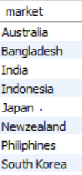
1. Provide the list of markets in which customer "Atliq Exclusive" operates its business in the APAC region.
Atliq Exclusive is operating its business with 8 different markets in the APAC region.

Slide 3
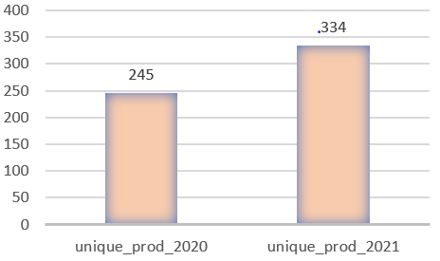

2. What is the percentage of unique product increase in 2021 vs 2020?
The total unique products has increased by 36.33% , from 245 to 334 around 90 products have been increased from 2020 to 2021.

Slide 4
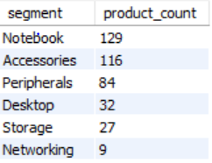
3. Provide a report with all the unique product counts for each segment and sort them in descending order of product counts.
When each segment is listed with unique product count we can easily find that number of unique products in Notebook , Accessories is significantly higher when compared to other segments.

Slide 5
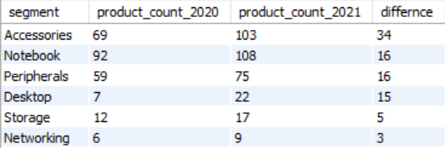
4. Follow-up: Which segment had the most increase in unique products in 2021 vs 2020?
The product variants are increasing each year and there’s a massive increase in Accessories and the product segments aren’t changing year by year its fixed.

Slide 6

5. Get the products that have the highest and lowest manufacturing costs.
AQ Home Allin 1 Gen 2 is the product with maximum manufacturing cost which is 240$ and AQ Master wired x1 Ms is the product with lowest manufacturing cost which is 0.9$ .

Slide 7
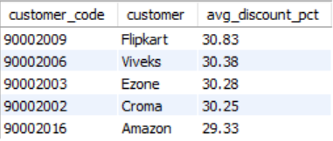
6. Generate a report which contains the top 5 customers who received an average high pre_invoice_discount_pct for the fiscal year 2021 and in the Indian market.
The average discount percentage is similar for the top 5 product its around 30 the customer with maximum discount percentage is Flipkart.

Slide 8
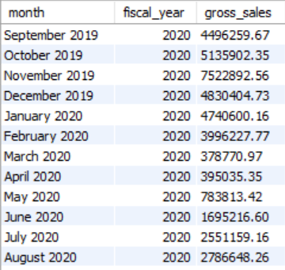
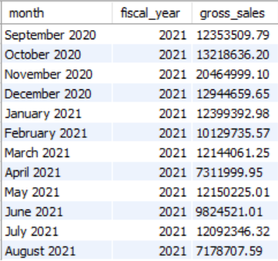
7. Get the complete report of the Gross sales amount for the customer Atliq Exclusive for each month. This analysis helps to get an idea of low and high-performing months and take strategic decisions.
We can find that maximum sales is given by November 2020 which belongs to the fiscal year of 2021 and the minimum sales is given by march 2020 of fiscal year 2020 .

Slide 9
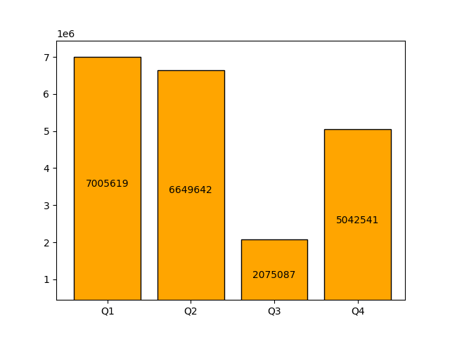
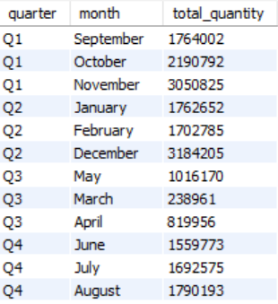
8. In which quarter of 2020, got the maximum total_sold_quantity?
In 2020 1st Quarter got the maximum total sold quantity and the 3rd Quarter got the minimum sold quantity.

Slide 10
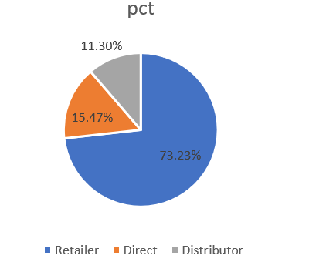
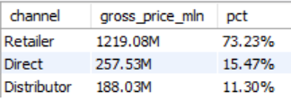
9. Which channel helped to bring more gross sales in the fiscal year 2021 and the percentage of contribution?
Retailer channel was responsible for bringing more gross sales in the fiscal year 2021 around ¾ was contributed by retailers .

Slide 11
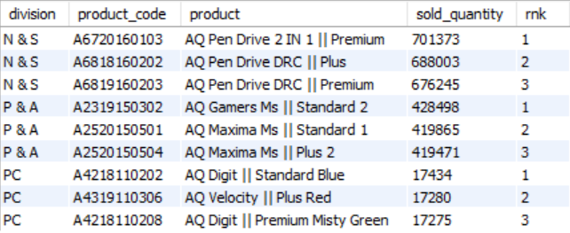
10. Get the Top 3 products in each division that have a high total_sold_quantity in the fiscal_year 2021?
Most of the products in the ranking lists are similar at least 2 of the products are similar in each division the only difference between them is each product has multiple variants. The sold quantity seems to be very less in PC division compared to other two divisions.

Slide 12
THANK YOU

